Slide 1
Building resilient communities for health and wellbeing.
18th March 2015
CDHN Belfast
Dr Mike Grady.
Principal Adviser
Institute of Health Equity.
Marmot |Review Team.
University College London.

Slide 2

Review of the Social Determinants of Health and the Health Divide in the WHO European Region
The CSDH – closing the gap in a generation
The Marmot Review – Fair Society Healthy Lives
Notes:
COMPLETED 3 REVIEWS : GLOBAL COMMISSION CLOSING THE GAP IN A GENERATION. ENGLISH REVIEW FAIR SOCIETY HEALTHY LIVES AND IN OCTOBER WE WILL FORMALLY PUBLISH THE EUROPEAN REVIEW OF THE SDH AND THE HEALTH DIVIDE.
CONSISTENCY OF MESSAGE FROM THE EVIDENCE:
HEALTH INEQUALITIES VARY CONSIDERABLY BETWEEN AND WITHIN COUNTRIES,ACROSS REGIONS AND ACROSS CITIES
THOSE INEQUALITIES ARISE FROM SOCIAL INEQUALITIES IN THE CONDITIONS IN WHICH PEOPLE ARE BORN, GROW, LIVE,LEARN, WORK AND AGE AND IN INEQUALITIES IN POWER,MONEY AND RESOURCES
THESE CONDITIONS LEAD TO AN ACCUMULATION OF BOTH DISADVANTAGE AND HEALTH HAZARD THROUGHOUT LIFE WITH EARLY CHILDHOOD EXPERIENCES HAVING THE MOST PROFOUND LIFELONG EFFECTS AS SET OUT I N GRAHAM ALLENS REVIEW OF EARLY YEARS.
THIS PERSISTENT INEQUALITY OF SOCIAL CLASS IS INTERWOVEN AND OVERLAID WITH DISADVANTAGE OF GENDER, ETHNCITY, SEXUAL ORIENTATION, DISABILITY, AGE RELIGION AND BELIEF.
THE EVIDENCE IS THAT SOCIALLY COHESIVE SOCITIES WITH DEVELOPED WELFARE STATES,HIGH QUALITY EDUCATION AND HEALTH SERVICES HAVE CREATED THE CONDITIONS WITHIN WHICH PEOPLE HAVE FREEDOM TO THRIVE AND FLOURISH.
THE GLOBAL RECESSION AND NATIONAL ECONOMIC CRISIS IN THE UK HAS EXACERBATED THE GAP AND EXPOSED STARK SOCIAL AND ECONOMIC INEQUALITIES.
A HUMAN RIGHTS APPROACH SUPPORTS PRIORITY TO IMPROVING HEALTH AND NARROWING THE GAP AS A MATTER OF SOCIAL JUSTICE.
INEQUALITIES IN HEALTH ARE WIDESPREAD,PERSISTENT,UNECCESSARY,DTRIMENTAL TO US ALL AND UNJUST.
THE EVIDENCE IS CLEAR WITH THE RIGHT CHIOCES OF POLICY PROGRESS CAN BE MADE.
2

Slide 3
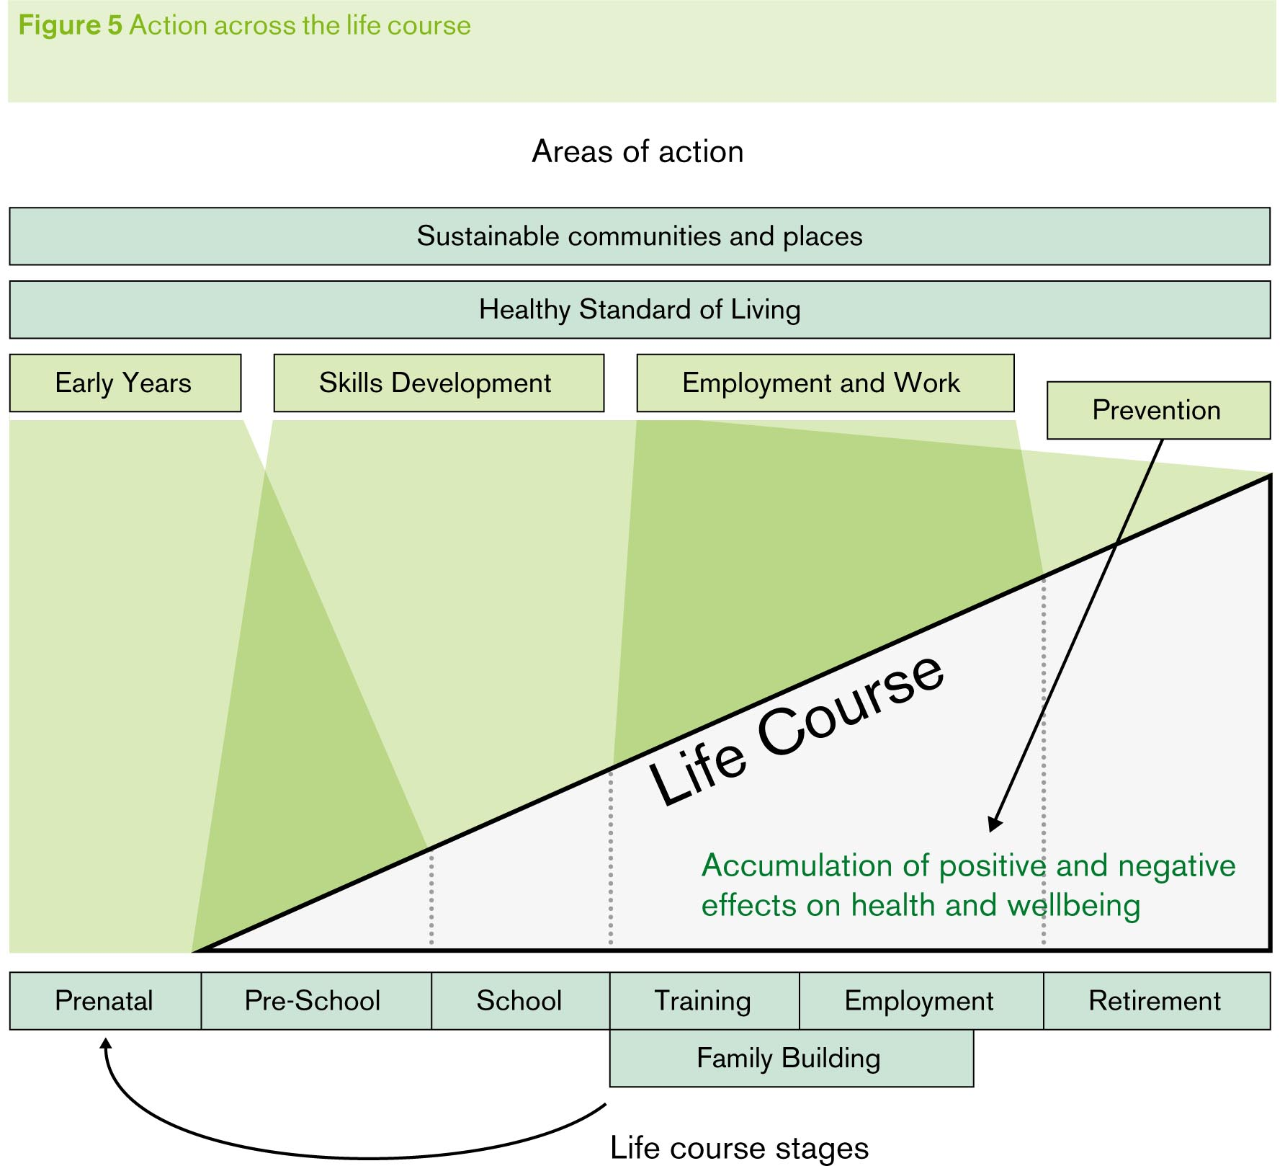
Notes:
INEQUALITIES ACCUMUALTE ACROSS THE LIFE COURSE AND RELATES TO SICIO ECONOMIC STATUS.
ECONOMIC ADVANTAGE AND DISADVANTAGE IS REINFORCED TO THE NEXT GENERATION EXARCERBATED BY OTHER INEQUALITIES GENDER , ETHNICITY ETC.
IN PARTICULR EDUCATION INEQUALITIES HAVE AN IMPACT OVER THE LIFE SPAN NOT JUST IN EDUCATION.
”DIFERENCE IN PARTICIPATION IN EDUCATION PERSIST THROUGHOPUT LIFE IMPACTING ON LIFE CHANCES,WEALTH , ACCESS TO HOUSING,AND POORER HEALTH. CLEAR SOCIAL GRADIENT IN HEALTH RELATED TO EDUCATIONAL STATUS : GRADUTES ARE SIGNIFICANTLY HEALTHIER THAN THOSE WITH NO QUALIFICATION.

Slide 4
Policy Objectives: The Social Determinants of Health
Give every child the best start in life
Enable all children, young people and adults to maximise their capabilities and have control over their lives.
Create fair employment and good work for all
Ensure a healthy standard of living for all
Create and develop healthy and sustainable places and communities
Strengthen the role and impact of ill-health prevention

Slide 5
Life expectancy
The difference in life expectancy at birth between the most and least deprived areas in England has dropped marginally from 7 years to 6.8 for females, and from 9.6 years to 9.2 years for men, between 2008/10 and 2010/12.
Inequalities in life expectancy are significantly worse for men than for women. For males, there are 36 local authorities with a gap between the most and least deprived areas, of 10 years or more, and 8 local authorities where the gap is greater than 10 years for females.
For males, there are 6 local authorities with a gap of 5 years or less, and for females there are 50 local authorities where the gap is 5 years or less
Notes:
Life expectancy drop – not significant.

Slide 6
Healthy life expectancy
The calculation for healthy life expectancy has changed to be based on a survey rather than
the census.
On average, women can expect to live until 64.1 years, and men to 63.4 in good health.
Inequalities in healthy life expectancy are greater than for life expectancy
For men, there is a 17.5 year gap between the area with the highest and lowest health expectancy,
and for women a 15.5 year gap.
There is particularly high level of variation in healthy life expectancy within deprivation
level, those performing less well should learn from those performing well
Notes:
Healthy life expectancy at birth is well below the pension age of the majority. People will need to continue to work in fair or poor health if they are to reach retirement age.
Survey: Healthy Life Expectancy at birth for Upper Tier Local Authorities: England, 2010-12, at: http://goo.gl/EfYHV4
How long in poor health: for women, 19.7 years, for men 16 years.

Slide 7
Level of development at end of reception
In 2011 - 59% of children had a good level of development.
The measurement system changed
Now 51.7% of all children, and 36.2% of those eligible for free school meals
achieved a good level of development at end of reception in 2012/13.
DfE have announced this measure will no longer be mandatory.

Slide 8
GCSE attainment
The attainment gap between the percentage achieving 5 or more GCSEs at grade A* to C or equivalent including English and Mathematics has narrowed by 2.1% between 2008/09 and 2012/13 with 38.1% of pupils known to be eligible for FSM achieving this indicator compared with 60.8% of all pupils.
Notes:
The attainment gap between the percentage achieving 5 or more GCSEs at grade A* to C or equivalent including English and mathematics has narrowed by 1.0 percentage point between 2008/09 and 2012/13 with 37.9 per cent of pupils known to be eligible for FSM achieving this indicator compared with 64.6 per cent of all other pupils. The attainment gap for the percentage achieving any 5 or more GCSEs at grade A* to C or equivalent narrowed by 8.0 percentage points between 2008/09 and 2012/13, with 69.3 per cent of pupils eligible for FSM achieving this indicator in 2012/13, compared with 85.3 per cent of all other pupils.
GCSE and Equivalent Attainment by Pupil Characteristics in England 2012/13, Department for Education, January 2014. (https://www.gov.uk/government/uploads/system/uploads/attachment_data/file/280689/SFR05_2014_Text_FINAL.pdf accessed 9th September 2014)

Slide 9
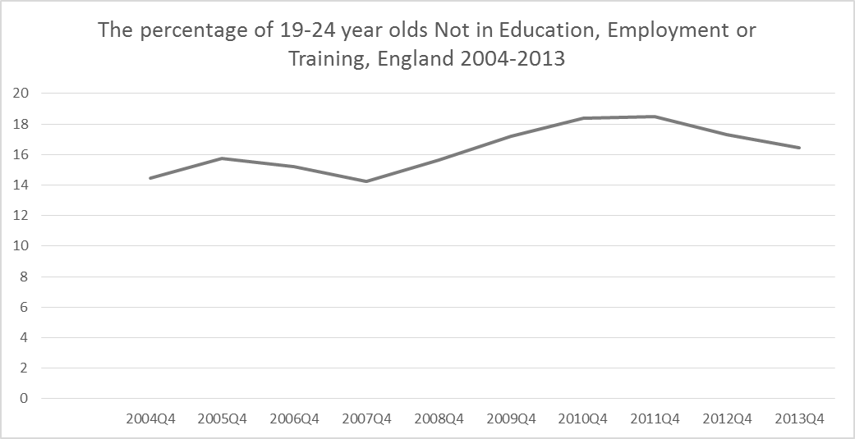
NEETS – not in education, employment or training.
We had previously reported on a younger age group, but change in policy
requires that all young people remain in education or training until 18.
16.4% of young people aged 19-24 were NEET in 2013, this marks a fall from
18.4% in 2010, but still higher than pre recession levels.

Slide 10
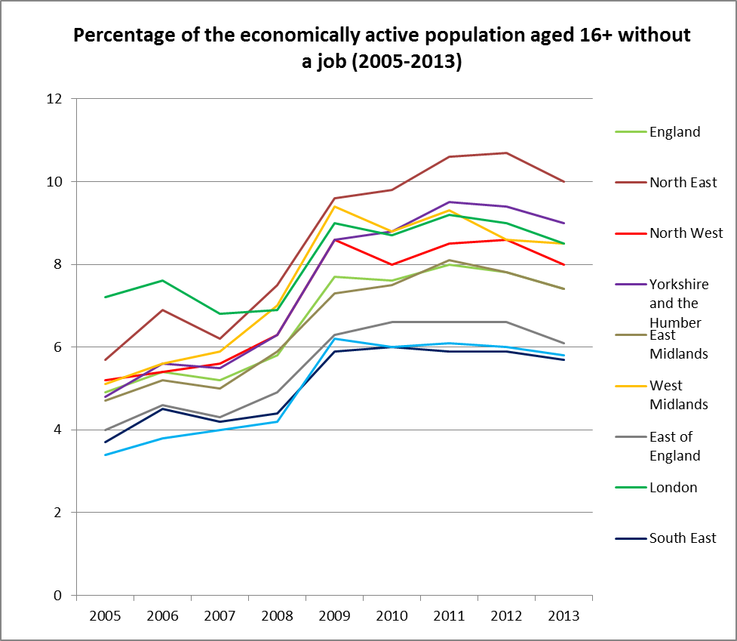
ONS NOMIS model-based estimates of unemployment, (www.nomisweb.co.uk), accessed 9 September 2014
In 2013 7.4% of those aged over 16 were unemployed.
Over 14% were unemployed in Birmingham and Hartlepool, compared to just 3.2%
unemployed in Rutland and 3.6% in Wokingham.
Positively, all regions have seen a drop in unemployment rates from their peak in 2011.
However, no region has seen their unemployment level reduce to their pre-crisis level.
Notes:
We had previously reported on those on means tested benefits, however with the
partial introduction of Universal credit – these are unreliable, this indicator along with
an income indicator.. Replace this measure
), the data for local authorities are ONS model-based estimates of unemployment. These figures are based on a model which utilises Annual Population Survey estimates of unemployment along with the number of people claiming Jobseekers Allowance (JSA) averaged over 12 months, from Claimant Count data. Estimates for England and English regions are from the Annual Population Survey and are not model-based estimates.

Slide 11
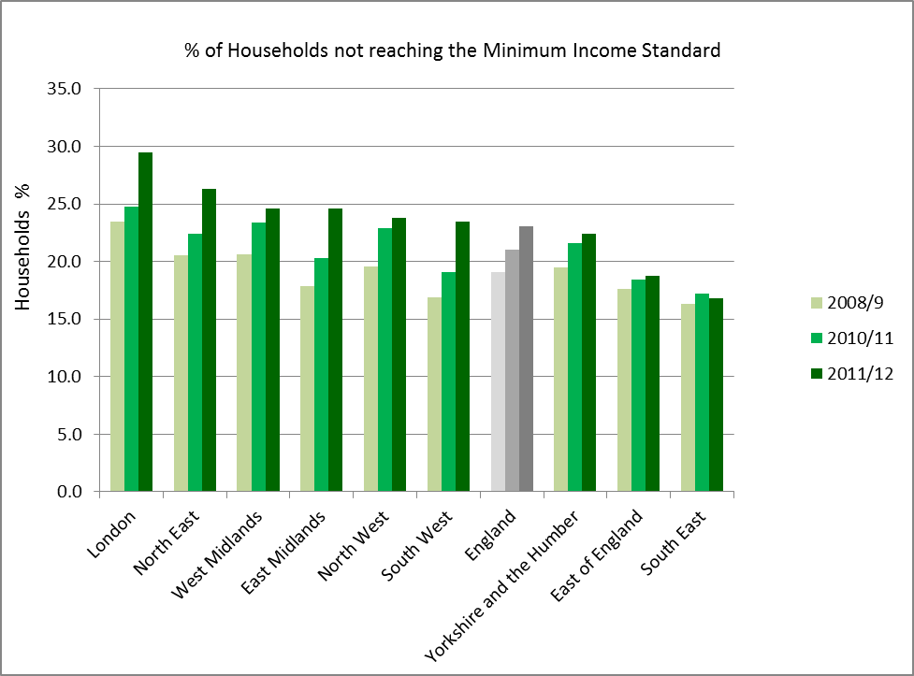
Data derived from analysis by Matt Padley and Donald Hirsch, Households Below a Minimum Income Standard 2008/9 to 2011/12, JRF
In 2011/12, 23% of households studied (which covers 2/3rds of household types in England)
did not receive enough income to reach an acceptable Minimum Income Standard (MIS).
In London, where costs are higher, one in four households (29.3%) did not receive enough income.
There has been a deterioration in living standards, with the proportion of people living in households
below MIS increasing by a fifth between 2008/9 and 2011/12 from 3.8 million to 4.7 million households
Notes:
The MIS is defined, as defined by the Joseph Rowntree Foundation as not having enough income to afford a 'minimum acceptable standard of living‘ EXPAND.
28% of couple households with children; 42% of under 35s living alone; 67% of lone parent families. 9% of pensioners.

Slide 12
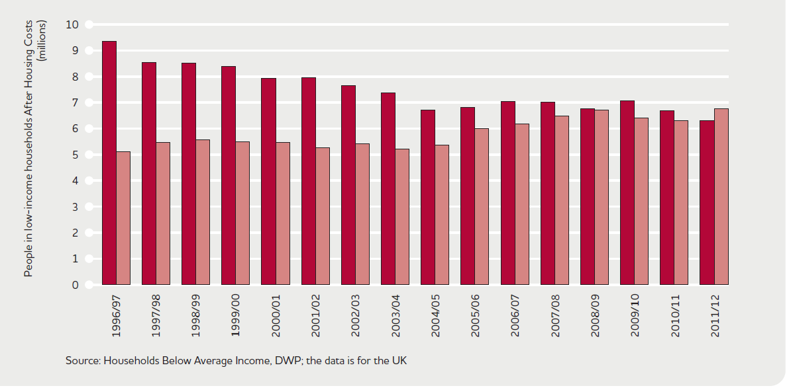
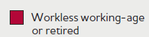

Create fair employment and good work for all. 6.7 million of the 13 million people in poverty are in working households, UK 2011/12
(JRF 2013 using DWP data)
Notes:
Recognise now that work is not a way out of poverty – not part of our work. But do you want this in anyway.

Slide 13
Use of green space
Monitor of Engagement with the Natural Environment, Natural Health England, September 2013
In England, 15.3% had visited the natural environment from March 2012 to
February 2013.
Green space important for more deprived communities and has impact on CVD.
However lower usage in more deprived areas.

Slide 14
Key messages
Inequalities persistent, unnecessary, harmful to all.
Clear social gradient worse your social circumstances the worse your health status
Clear inequalities in child development with significant variations.
Poverty and income inequalities critical.
Gender differences.
Youth Unemployment and NEETS a key issue now and for future.
Significant Regional Variations.
Need concerted action which addresses inequalities across the gradient but also accounts for greater disadvantage.
Notes:
Inequalities in life expectancy at birth are not significantly different and there are a number of factors that will be hampering progress to reduce inequalities and improve people’s lives.
Clear inequalities evident in children’s development, difficult to know if this is worse because DfE keep changing the measures.
Improvement in early years provision, parenting support, reduction of child poverty
Stable measures of development to help track progress.
Nearly a quarter of households do not have enough money to live on and this has been increasing. More than half of those in poverty are in work.
Government to identify policy lead for ensuring sufficient incomes, with plan of action.
Employers to take responsibility for ensuring that work pays sufficiently.

Slide 15


People and Places
Critical linkage of health, wellbeing and resilience.
Evidence of linkage of low level stress, depression and exclusion are barriers to participation.
“ You can see the deprivation, all you have to do is look outside. Its in your face every day, litter everywhere, rats and rubbish. It’s a dump……it feels like people around you have no meaning to life. I keep my curtains closed at times….It doesn’t give you a purpose to do anything” (Focus group participant)
Many communities are characterised by lack of mutual trust, isolation and under developed social cohesion.
Notes:
EVIDENCE SHOWS CRTICAL IMPORTANCE AND INTERLINKAGE OF HEALTH WELLBEING AND RESILIENCE.
LYNNE FREIDLI WORK FOR WHO EUROPE IS PARTICULARILY SIGNIFICANT MENTAL HEALTH,HEALTH INEQUALITIES AND RESILIENCE.
SO TOO DANNY DORLING ACTION ON SPACIAL SEGREGATION OF OUR CITIES WITH GHETTOS OF SOCIAL HOUSING AND THE IMPACT ON HEALTH INEQUALITIES
PLACE,SPACE AND ENVIRONMENT HOLD GRAET IMPORTANCE ON
HEALTH AND WELLBEING
ACTIVITY
PSYCHSOCIAL WELLBEING
AIR QUALITY
NOISE
INJURIES
SUSTAINABLE HOUSING AND ENERGY.
FEELING GOOD ABOUT WHERE WE LIVE = 200% LESS LIKELY TO BE IN LOWEST GROUP FOR MENTAL HEALTH

Slide 16

Building Healthier Communities. PHE . DH London February 2015.

Slide 17
Building resilient Communities.

Slide 18
Health, Wellbeing and resilience
Evidence participation and improving life skills ameliorates impact of health inequalities through developing social support networks. (Bynner and Parsons 2006)
Learning and skill development impact positively and fosters community action.
“ I know what makes me healthy and that is being happy and having friends” (Susanne)
Social networks create the conditions in which people thrive
“ I would say that people in the group have more confidence. At one point they would have been sat at home doing nothing ,now they are out and are involved. Once you get there it ‘s amazing to see how far you can go.” (Joyce)

Slide 19
A Guide to community centred approaches for health and wellbeing. PHE February 2015

Slide 20
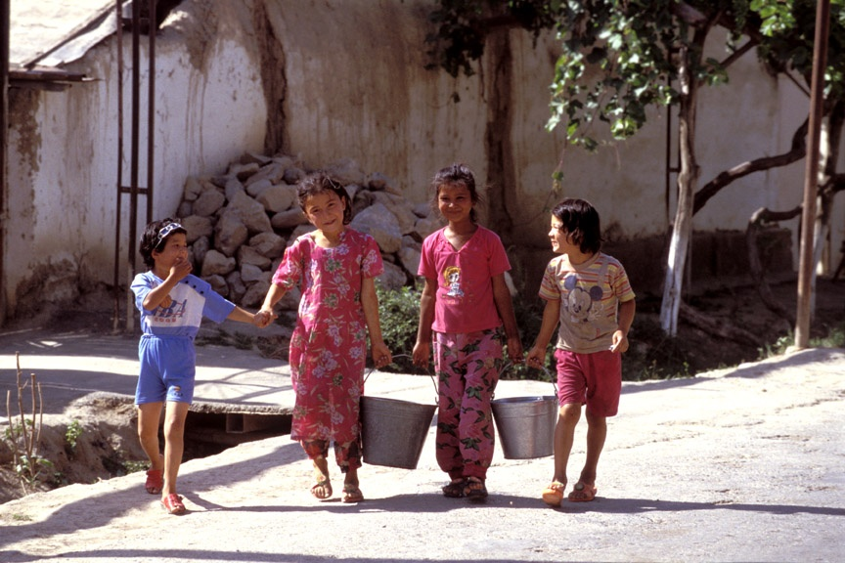
Creating conditions in which individuals and communities have control over their health and lives and
participate fully in society
Notes:
20

