Slide 1
Joanne Morgan Director Community Development and Health Network

Slide 2
About CDHN
Health inequalities are the unfair and avoidable differences in the health status of people in our society.
Health inequalities are killing people on a grand scale.
CDHN exists because this must stop.
Fairer, more equal society
People’s lives, health and wellbeing are improved

Slide 3
Why Co-Production…Why now?
Imperative from social justice, community and political perspective
WE HAVE TO DO SOMETHING DIFFERENT
We need Transformational Co Production

Slide 4
The Principles and their significance
Recognising people as assets.
Building on people’s existing capabilities.
Promoting mutuality and reciprocity.
Developing peer support networks.
Breaking down barriers between professionals and recipients.
Facilitating rather than delivering.

Slide 5
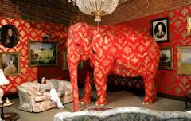
Isn't it just the Emperors new clothes?
No…let me introduce the elephants in the room…
Discomfort
Risk
Power
Inequality
Notes:
if you want us to step up – you’ve got to step down".
The world of helping others is built around one-way transactions which send two unintentional messages:
We have something you need,
but you have nothing we need or want or value.
The way to get more help is by
coming back with more problems.
Edgar Cahn

Slide 6
What we have learned
Do sweat the small stuff
Not everything is (has to be) Co Production
Language matters
Facilitation matters
Relationships matter
The three P’s – patience, persistence
and perseverance
Change will happen! BUT…….
Only with fidelity to the principles
Notes:
If co-production means whatever people choose it to mean, then ultimately it will cease to mean anything at all.
Tinkering round the edges won’t cut it

Slide 7
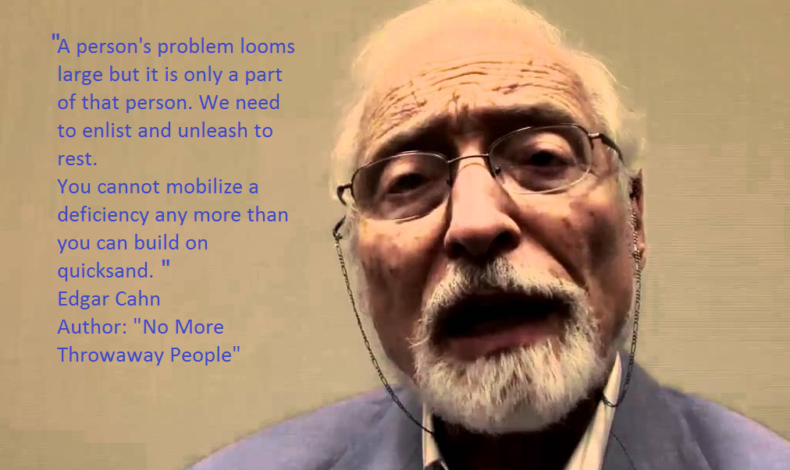
A final thought…..

