Slide 1
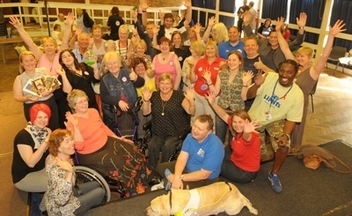
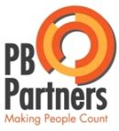
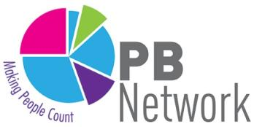
Participatory Budgeting
Builds Wellbeing
Jez Hall Shared Future CIC

Slide 2
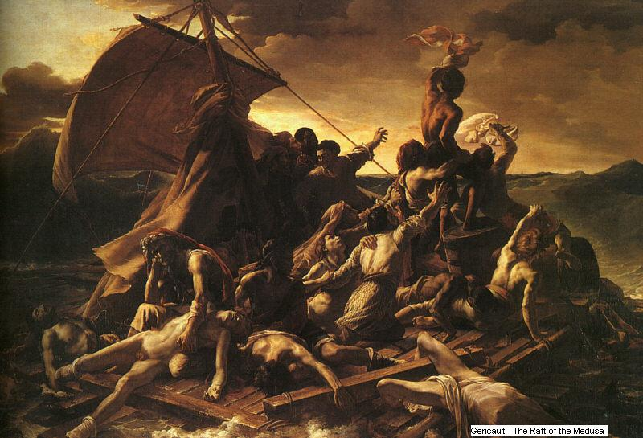
TRENDS
The graph of doom – Demographics + Austerity

Slide 3
TRENDS
A carbonised economy and climate change

Slide 4
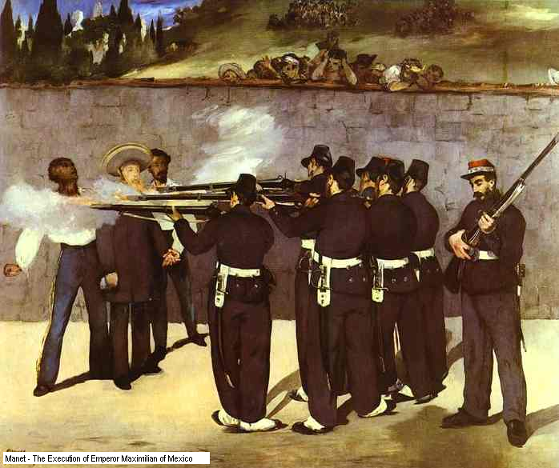
TRENDS
Democratic deficits and social inequality

Slide 5
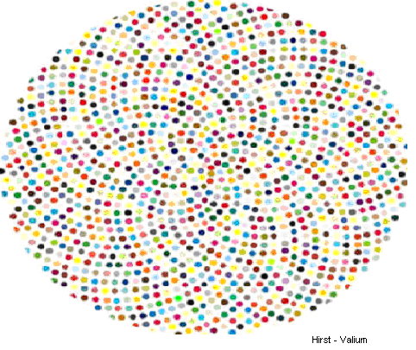
TRENDS
Atomised communities and social isolation

Slide 6
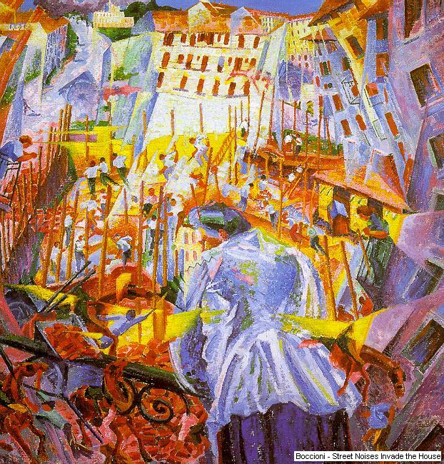
OPPORTUNI TY
Participation alongside Representation:
“Democracy is not a spectator sport”

Slide 7
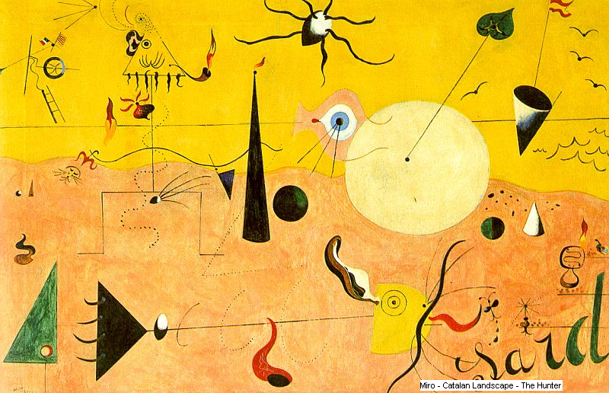
OPPORTUNI TY
Connected communities and infectious ideas

Slide 8
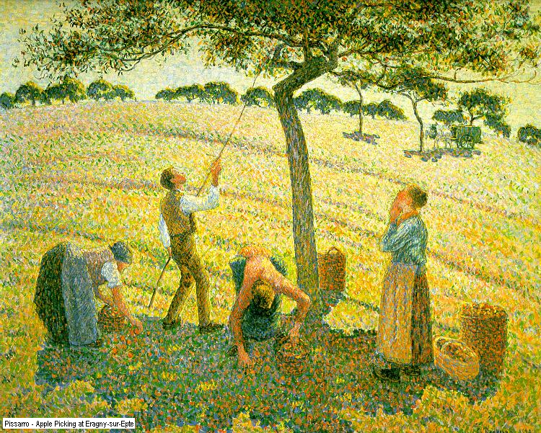
OPPORTUNI TY
Co-operation, co-production and volunteering

Slide 9
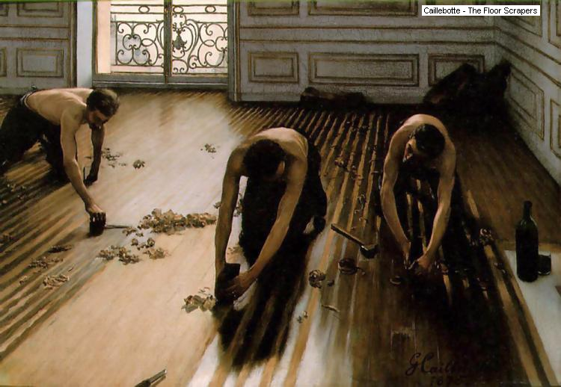
LEVERS
Human nature is good – work with that grain

Slide 10
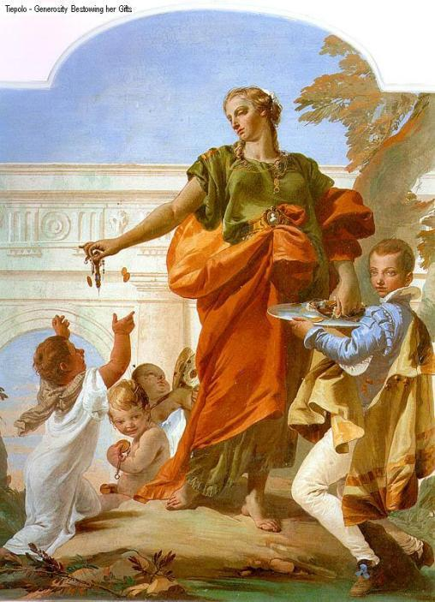
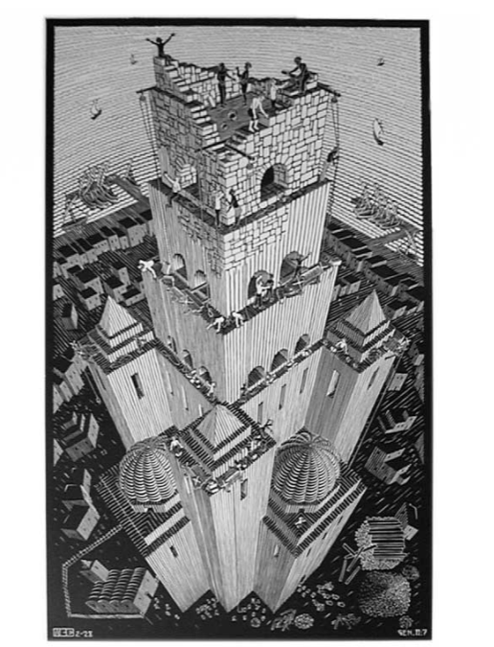
LEVERS
Models of devolved leadership and co-production

Slide 11
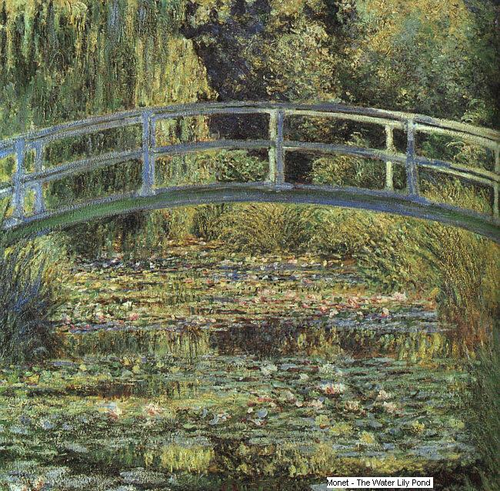
LEVERS
Positive deviance and bridging Social Capital

Slide 12
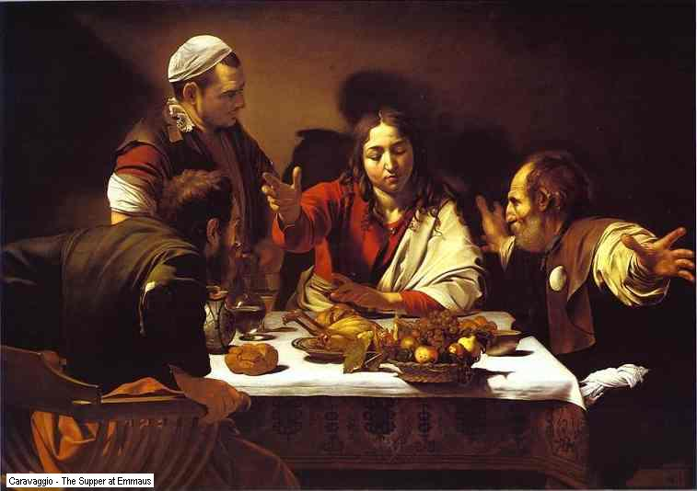
LEVERS
Deliberative Spaces – On and Offline

Slide 13
P L A
Y
YOUR
P
AR
T
Modelling Good Behaviour

Slide 14
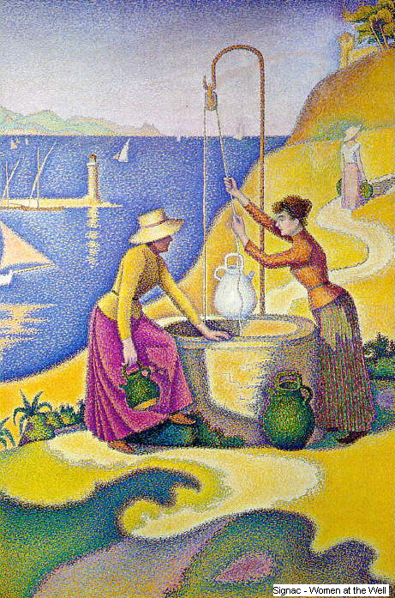
P L A
Y
YOUR
P
AR
T
Wellbeing
comes from
Forging Relationships
and
Mutual Support

Slide 15
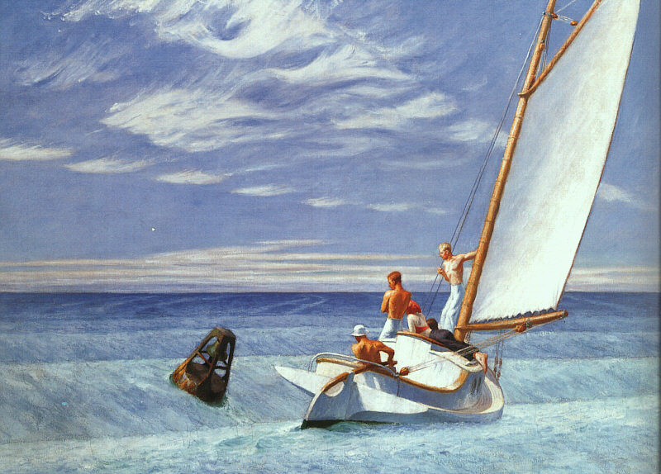
P L A
Y
YOUR
P
AR
T
Combining our Experiences and our Energies

Slide 16
What I believe about PB
P A R T I C I P A T I O N
Encourages volunteering
Shows there is ‘a healthy community’
Increases ‘happiness’ with democracy
Breeds mutual respect and understanding
A sense of belonging and ‘social capital’
Leads to stronger partnership working
Drives resources to the grassroots

Slide 17
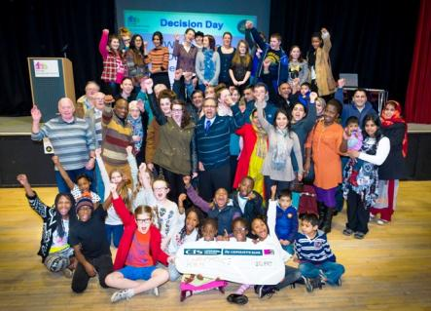
P A R T I C I P A T I O N
What is Participatory Budgeting?
Local people (citizens) making Direct Decisions over how to spend public money... But not all the budget!
Supported by experts and politicians
Empowering, not manipulating.
Asset based approach to co-production
A personalised budget... For a whole community!
Community led commissioning FOR REAL:
Real money, real decisions, real responsibility.
‘If it feels like we have decided ---- it’s PB.
If it feels like someone else has decided, it isn’t.’
Brazilian resident involved in PB

Slide 18
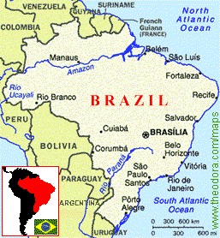
P A R T I C I P A T I O N
Origins of Participatory Budgeting
Began in Porto Alegre, Brazil in 1980s – city of more than 1.5m people
End of military dictatorship and election of Workers’ Party
Public coffers were dry, needs pressing and democracy needed to be done differently
= innovation!

Slide 19
The Empowerment Line PB works in different ways, but should be meaningful and change how money is spent
P A R T I C I P A T I O N
Consulting
Partnership
Decision making
Communicating
Involving
Scope of PB activity
Passive engagement (not PB?) Empowerment through PB
Progression

Slide 20
P A R T I C I P A T I O N
Yr 1
Evaluation and Learning
Design
Yr 2
Scrutiny and Monitoring
PB budget cycle =
participatory activity at all stages
Informing and engaging
Yr 3
Yr 4
Delivery of new projects
Setting
of
Priorities
Decision Making
Develop budget
Ideas

Slide 21
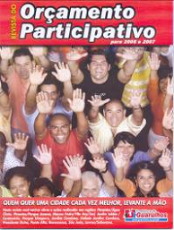
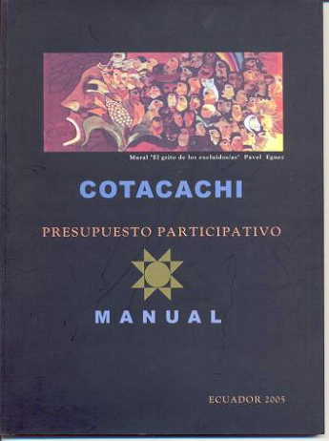
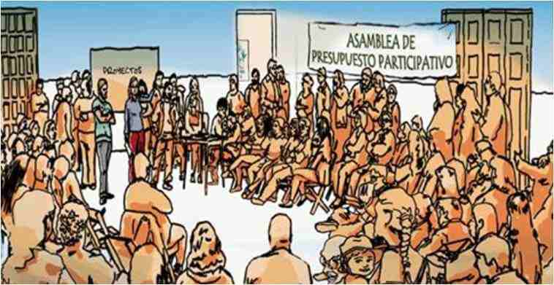
P A R T I C I P A T I O N
Around the world...
Recife
Winner of Reinhart Mons Democracy Prize in 2011
Offline and Online participation that reached hundreds of 100,000s of the population.
Over 3000 recorded PB experiences worldwide

Slide 22
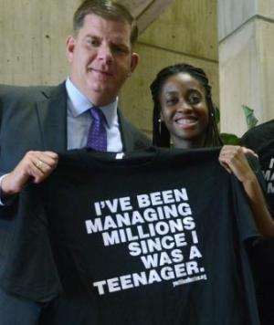
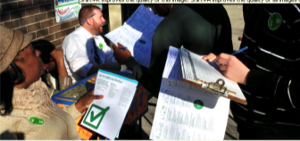
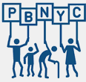
P A R T I C I P A T I O N
Around the world...
USA and Canada
Chicago was first major programme $1m... Now $6m
New York growing from $4m ................. to $32m per year
City of Boston: $1m of PB capital funds branded as Youth Lead the Change:

Slide 23
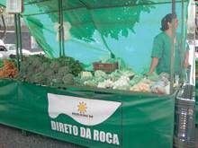
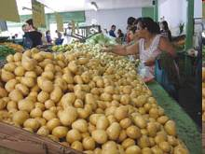
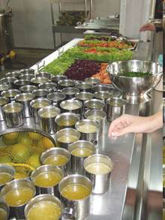
P A R T I C I P A T I O N
Around the world...
BELO HORIZONTE, BRAZIL
The city that ended hunger
“To search for solutions to hunger
means to act within the principle that ….
the status of a citizen surpasses that of a mere consumer.”

Slide 24
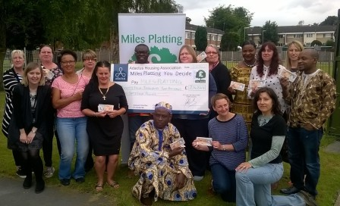
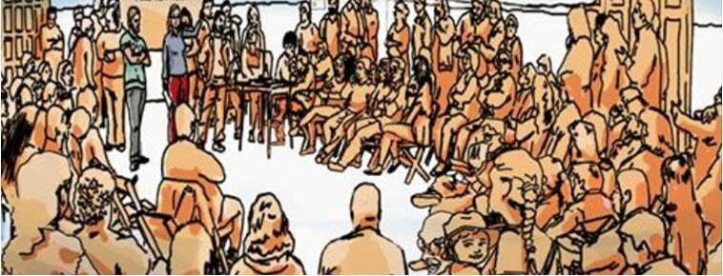
Two basic models in the UK
P A R T I C I P A T I O N
Participatory Grant making
Local people deciding on local funding
Community Led Commissioning
aka Community led Budgets

Slide 25
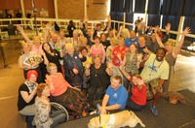
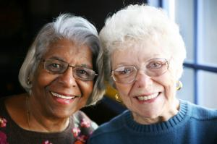
W E L L
-
B
E
I
N
G
Health related PB...
Southampton, Thornhill: Your Community, Your Health, Your Voice (2006 and still ongoing)
Well London: uses Participatory Budgeting to improve health and wellbeing (2012-15)
Leicester Health in your hands: Using PB to tackle lung disease (2013)
Due North Health Equity report recommends more participatory budgeting (2014)
North Tyneside NHS: Access to Urgent Care Commissioning Cubes (2015)
Connect Hackney Aging Better: Over-50s vote on £1.5m funded by the lottery (2015-16)
“I feel like I am somebody”

Slide 26
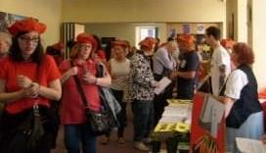
W E L L
-
B
E
I
N
G
Health related PB... In Scotland
Edinburgh: Canny Wi Cash Older People’s PB (2013)
Richmond Fellowship Scotland: Outcomes are Fun (2013)
Edinburgh South West Health Matters
£40k+ for healthy activities (Dec 2016)
North Ayrshire £50K mental health PB (2017)

Slide 27
W E L L
-
B
E
I
N
G
Health related PB... Not just me then...
...across time in different municipalities I find a robust pattern linking the use of participatory budgeting to a change in the pattern of government expenditures ...
adopting municipalities tend to increase the spending on health and sanitation significantly more than their non-participatory counterparts.
The Effects of Participatory Budgeting on Municipal Expenditures and Infant Mortality in Brazil, by Sonia Goncalves, King’s College London, UK.

Slide 28
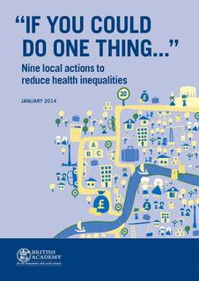
W E L L
-
B
E
I
N
G
Mental Capital and PB
In a 2014 British Academy report on
reducing health inequality entitled:
“If you could do one thing”
Professor Kwame McKenzie, respected Canadian expert on mental health, proposes
"Using PB to Improve Mental Capital at the Local Level".
“I have no doubt that there will be locally chosen and appropriate initiatives that promote mental capital.
But participatory budgeting, if done correctly, has the potential to leverage those for even greater benefit, as well as developing resilient and socially cohesive populations.”

Slide 29
Talk to me
S
H
A
R
E
D
F
U
T
U
R
E
W: www.sharedfuturecic.org.uk
E: jez.hall@sharedfuturecic.org.uk
T: 07963 706106

