Slide 1
Principal Environmental Health Officer – Health and Well Being
Alison Briggs

Slide 2
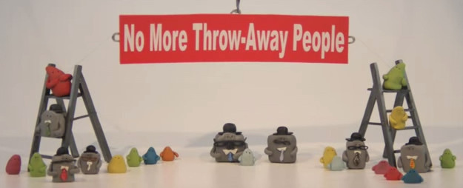
Blobs and the Squares
https://www.youtube.com/watch?v=egav5xjb-lg

Slide 3
Find ways to give people the opportunity to bring their experiences and knowledge,
and,
together find ways to develop a shared agenda

Slide 4
Get to the place where you can see the community through the eyes of the community

Slide 5
Be Prepared for a challenge –
Self Reflection is key.
Feels messy, uneasy and unsettling – stay with it.
Learn to hold your nerve.
Put in the time.

Slide 6
Duneane Community Champions are a proactive, enthusiastic collective committed to promoting health and well-being and creating a strong and connected community
Notes:
Alison

Slide 7
Duneane Community Champions established as a “collective”
Community Health Champion OCN Level 2 training course (2 cohorts)
Vision statement, logo, asset map, local history booklet, time-bank, Men’s Shed, Community Garden, Art Projects…
Community Spirit Day – 19th March 2016
Action Plan looking at 5 ways to well being, training, community spirit day 2017…
Notes:
Over a two year process for the Council to date
Research and working alongside CDHN
Liaised with Community Representative to get buy in
Community Health Champion Training
Meeting with Community Health Champions
Second round of training organised – promoted by first cohort.
Community health champion training – evenings (to not exclude)
Asset Map
Meetings to plan for the community spirit day
Community Spirit day - concept generated in group and planned and delivered by the health champions
Local history booklet
Logo developed
Time Bank established

Slide 8
Duneane Community Champions
https://vimeo.com/204502501

Slide 9
Outcomes – Phase One
Groups/Community
Relationships with Statutory
Individual

Slide 10
Challenges…
How do we measure / What do we need to measure?
Resources?
Other Statutory/community/voluntary bodies to be involved?

